Slide 1
Analysis for Employee Retention Using R
Submitted by: Bina Maria
Saumya Bhatnagar
Saurav P. Shrestha

Slide 2


The business growth is getting slow, because my experienced employees are leaving! I need someone to observe the data and predict which employees may leave the company.. But how?
I might be helpful here. Let me analyze the available data and provide you insights, and may be we can predict which employees might be leaving the company soon!
Vice President
Intern – Data Analyst

Slide 3

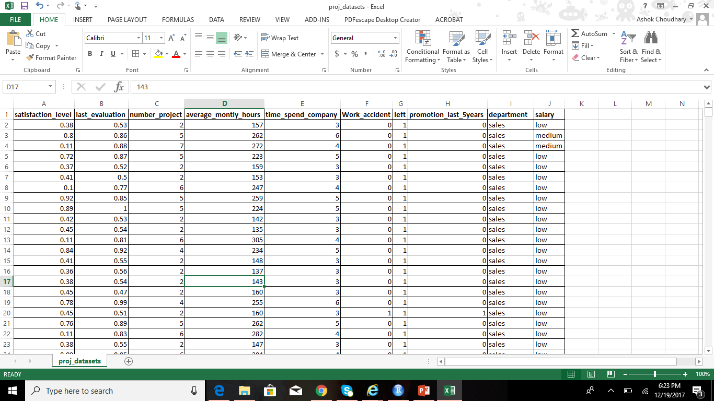
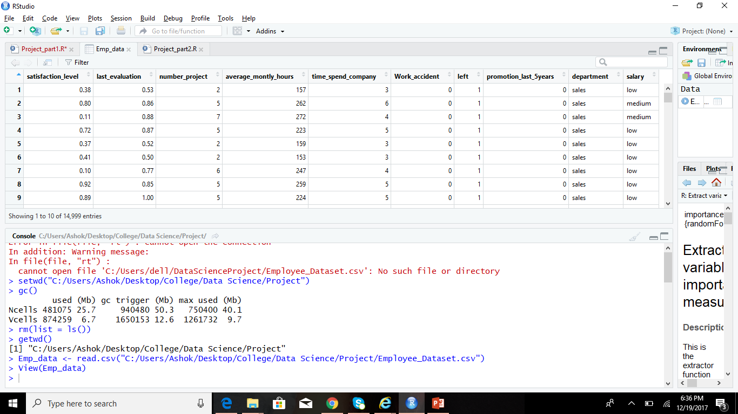
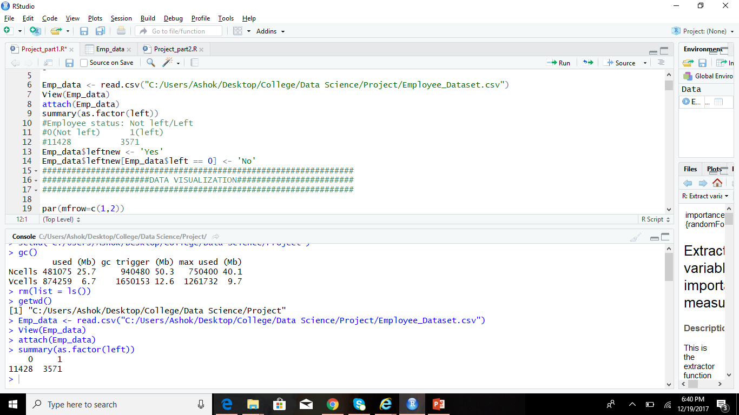
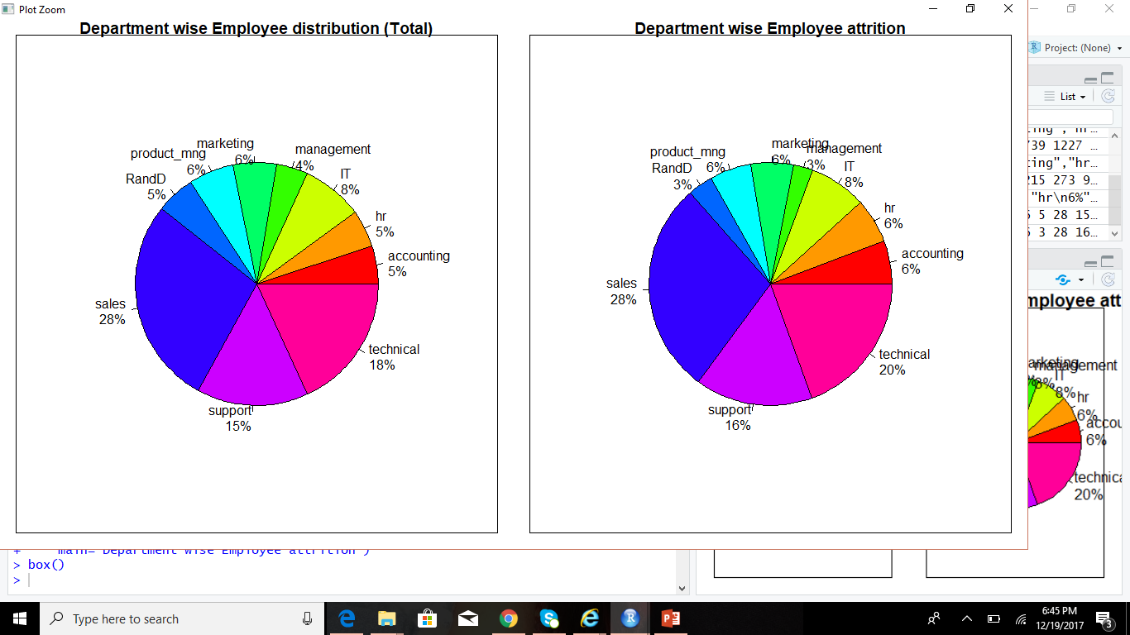
Data Visualization
Let us take the data and upload it in ‘R’ to visualize it
Notes:
######DEPARTMENT WISE DISTRIBUTION AND ATTRITION################
par(mar = c(1,1,1,1))
deptdata <- Emp_data$department
deptdatatable <- table(deptdata)
percent<- round(deptdatatable*100/length(deptdata))
lbls <- paste(names(deptdatatable), "\n", percent, "%", sep="")
pie(deptdatatable, labels = lbls, col = rainbow(10),
main="Department wise Employee distribution (Total)")
box()
#accounting hr IT management marketing product_mng RandD
#767 739 1227 630 858 902 787
#sales support technical
#4140 2229 2720
deptleft <- Emp_data$department[left == 1]
deptlefttable <- table(deptleft)
percentleft<- round(deptlefttable*100/length(deptleft))
lbls <- paste(names(deptlefttable), "\n", percentleft, "%", sep="")
pie(deptlefttable, labels = lbls, col = rainbow(10),
main="Department wise Employee attrition")
box()
#accounting hr IT management marketing product_mng RandD
#204 215 273 91 203 198 121
#sales support technical
#1014 555 697

Slide 4
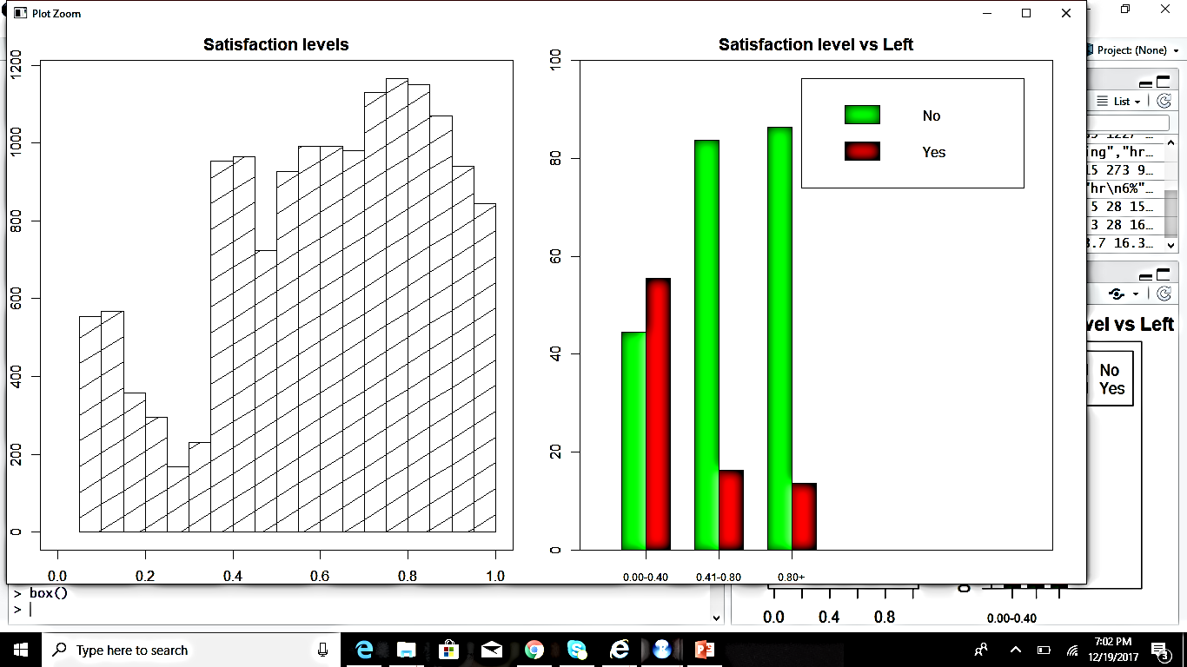
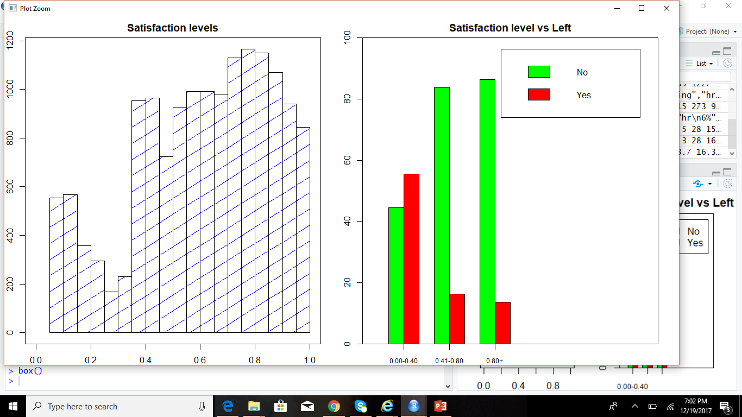
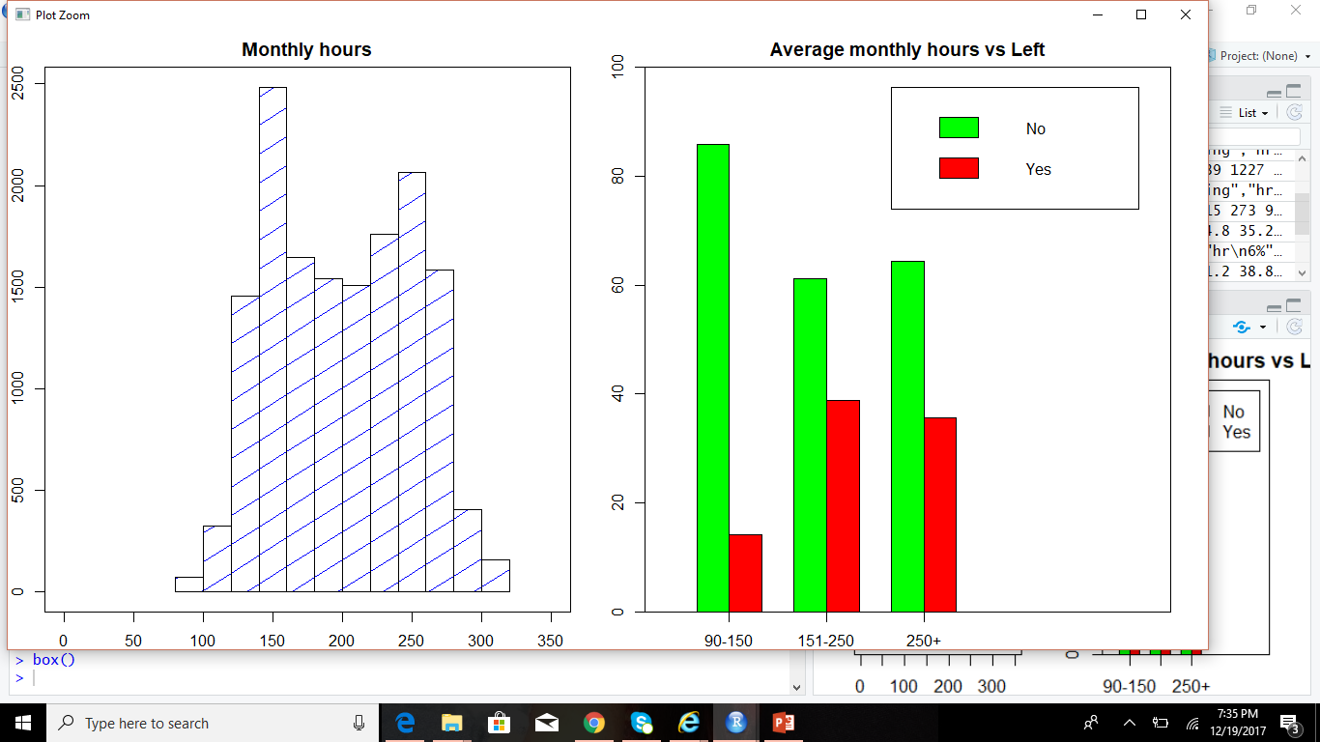
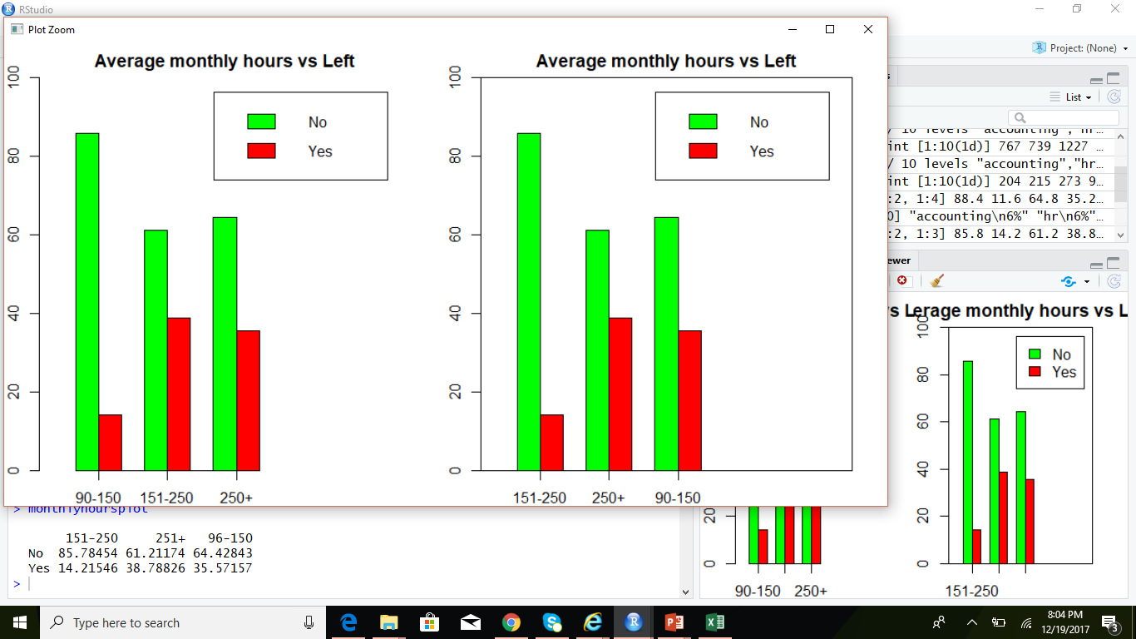
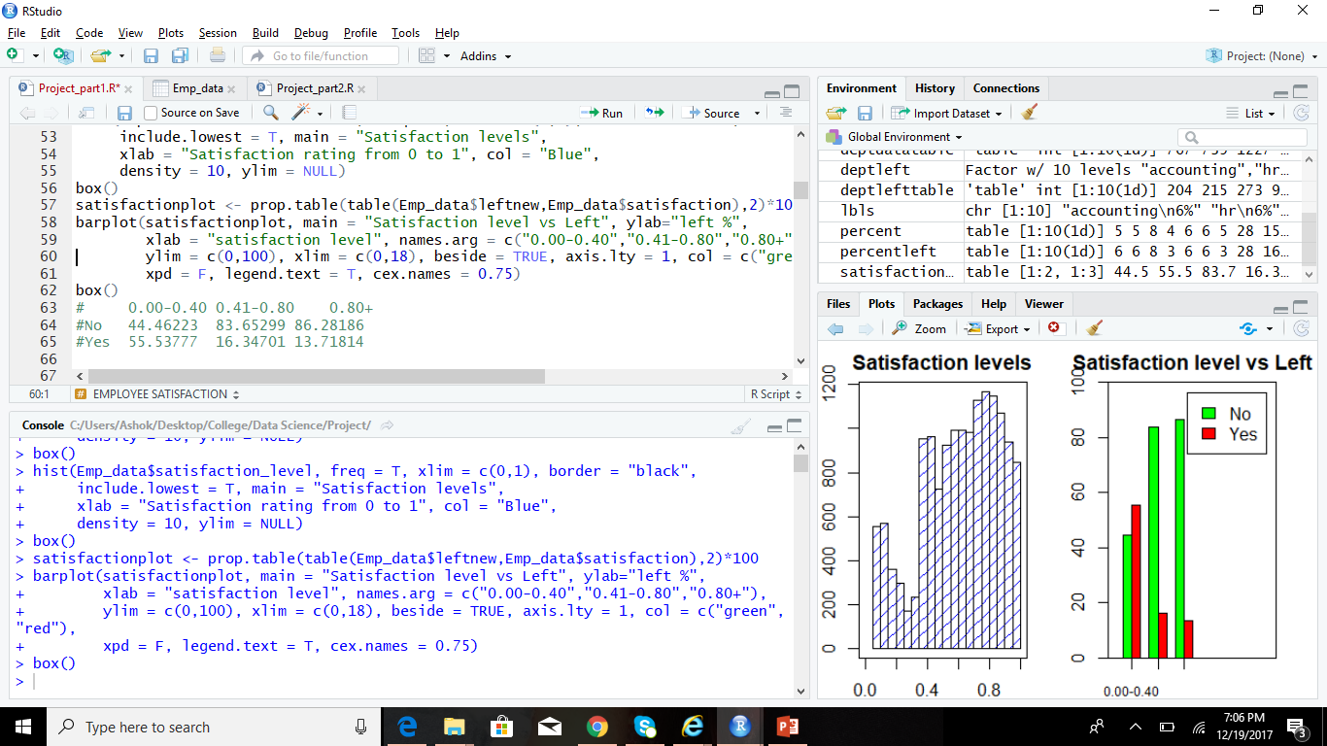
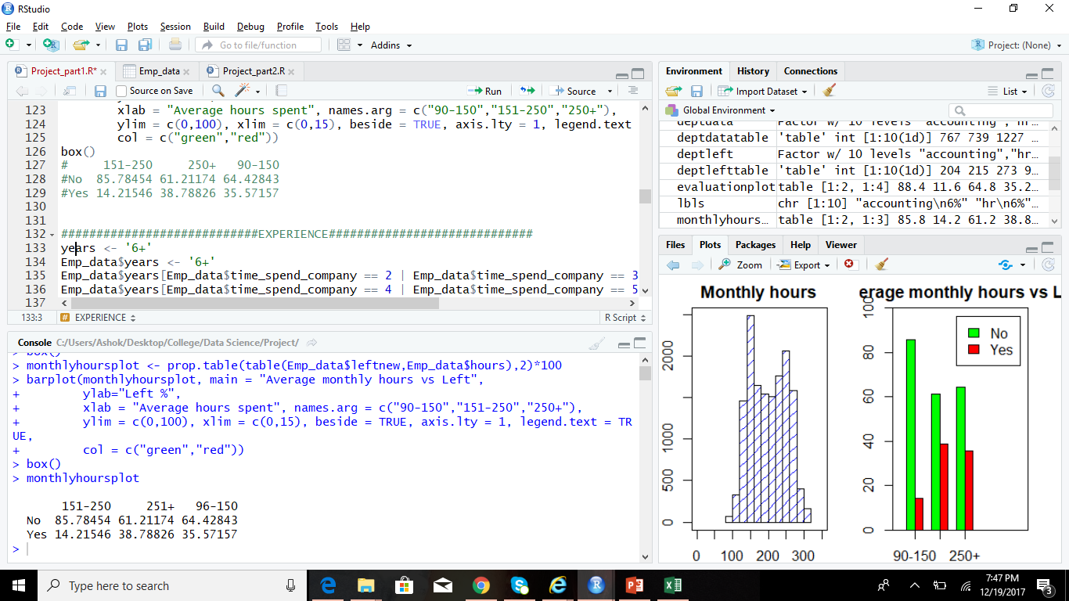
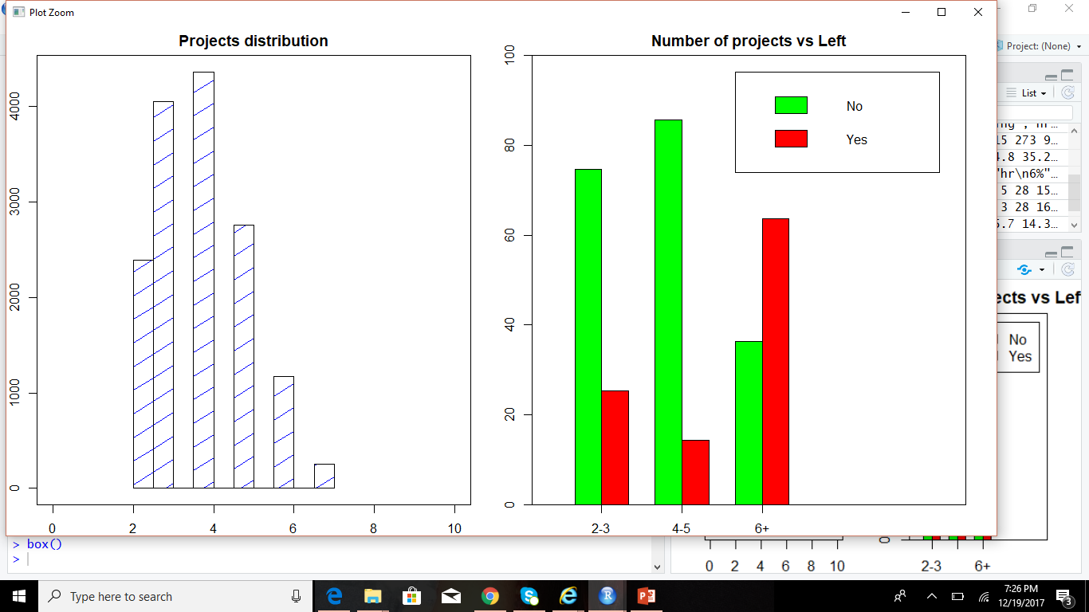
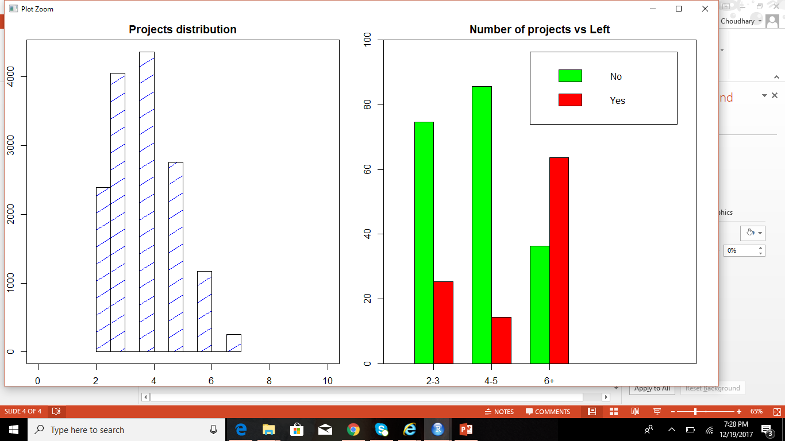
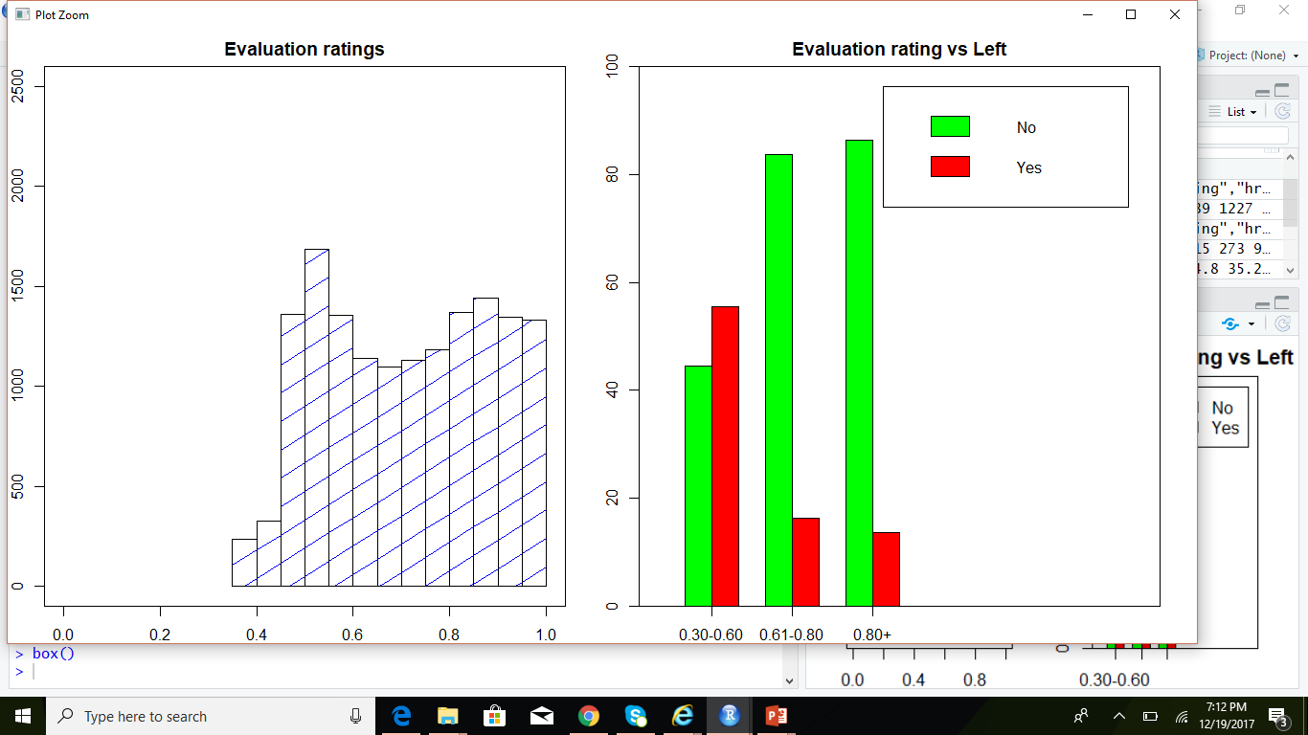
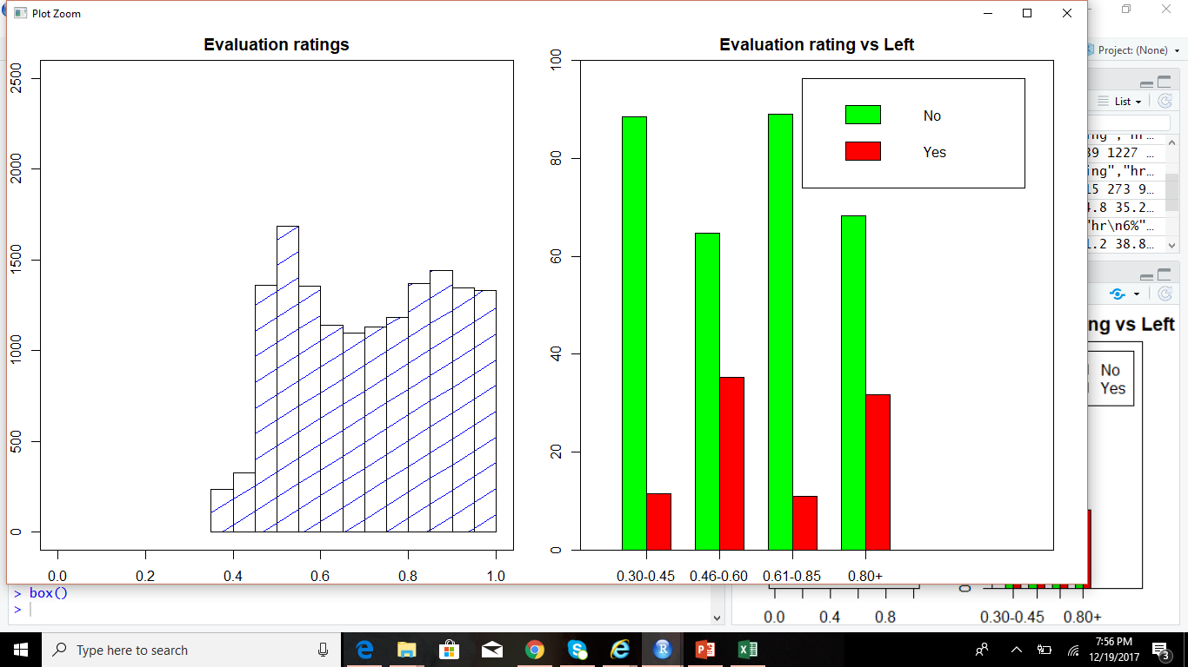
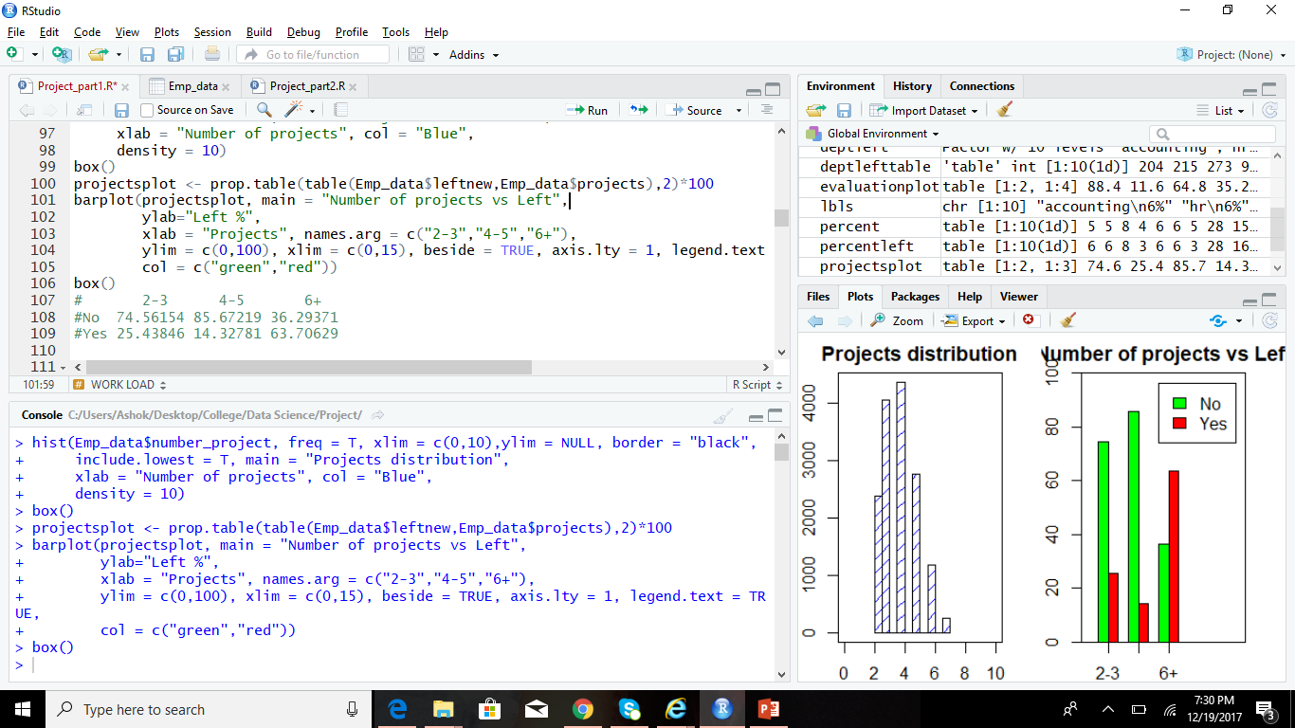
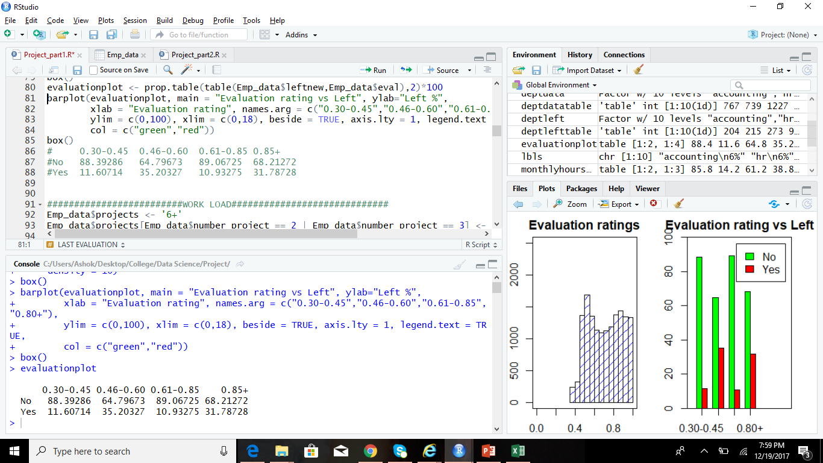
Data Visualization
Notes:
#####################EMPLOYEE SATISFACTION########################
Emp_data$satisfaction <- '0.80+'
Emp_data$satisfaction[Emp_data$satisfaction_level >= 0.00 & Emp_data$satisfaction_level <= 0.40] <- '0.00-0.40'
Emp_data$satisfaction[Emp_data$satisfaction_level >= 0.41 & Emp_data$satisfaction_level <= 0.80] <- '0.41-0.80'
hist(Emp_data$satisfaction_level, freq = T, xlim = c(0,1), border = "black",
include.lowest = T, main = "Satisfaction levels",
xlab = "Satisfaction rating from 0 to 1", col = "Blue",
density = 10, ylim = NULL)
box()
satisfactionplot <- prop.table(table(Emp_data$leftnew,Emp_data$satisfaction),2)*100
barplot(satisfactionplot, main = "Satisfaction level vs Left", ylab="left %",
xlab = "satisfaction level", names.arg = c("0.00-0.40","0.41-0.80","0.80+"),
ylim = c(0,100), xlim = c(0,18), beside = TRUE, axis.lty = 1, col = c("green","red"),
xpd = F, legend.text = T, cex.names = 0.75)
box()
# 0.00-0.40 0.41-0.80 0.80+
#No 44.46223 83.65299 86.28186
#Yes 55.53777 16.34701 13.71814
#####################LAST EVALUATION#############################
Emp_data$eval <- '0.85+'
Emp_data$eval[Emp_data$last_evaluation >= 0.30 & Emp_data$last_evaluation <= 0.45] <- '0.30-0.45'
Emp_data$eval[Emp_data$last_evaluation >= 0.46 & Emp_data$last_evaluation <= 0.60] <- '0.46-0.60'
Emp_data$eval[Emp_data$last_evaluation >= 0.61 & Emp_data$last_evaluation <= 0.85] <- '0.61-0.85'
hist(Emp_data$last_evaluation, freq = T, xlim = c(0,1),ylim = c(0,2500), border = "black",
include.lowest = T, main = "Evaluation ratings",
xlab = "Evaluation rating from 0 to 1", col = "Blue",
density = 10)
box()
evaluationplot <- prop.table(table(Emp_data$leftnew,Emp_data$eval),2)*100
barplot(evaluationplot, main = "Evaluation rating vs Left", ylab="Left %",
xlab = "Evaluation rating", names.arg = c("0.30-0.45","0.46-0.60","0.61-0.85","0.80+"),
ylim = c(0,100), xlim = c(0,18), beside = TRUE, axis.lty = 1, legend.text = TRUE,
col = c("green","red"))
box()
# 0.30-0.45 0.46-0.60 0.61-0.85 0.85+
#No 88.39286 64.79673 89.06725 68.21272
#Yes 11.60714 35.20327 10.93275 31.78728
#########################WORK LOAD#############################
Emp_data$projects <- '6+'
Emp_data$projects[Emp_data$number_project == 2 | Emp_data$number_project == 3] <- '2-3'
Emp_data$projects[Emp_data$number_project == 4 | Emp_data$number_project == 5] <- '4-5'
hist(Emp_data$number_project, freq = T, xlim = c(0,10),ylim = NULL, border = "black",
include.lowest = T, main = "Projects distribution",
xlab = "Number of projects", col = "Blue",
density = 10)
box()
projectsplot <- prop.table(table(Emp_data$leftnew,Emp_data$projects),2)*100
barplot(projectsplot, main = "Number of projects vs Left",
ylab="Left %",
xlab = "Projects", names.arg = c("2-3","4-5","6+"),
ylim = c(0,100), xlim = c(0,15), beside = TRUE, axis.lty = 1, legend.text = TRUE,
col = c("green","red"))
box()
# 2-3 4-5 6+
#No 74.56154 85.67219 36.29371
#Yes 25.43846 14.32781 63.70629
#########################AVERAGE MONTHLY HOURS#############################
Emp_data$hours <- '251+'
Emp_data$hours[Emp_data$average_montly_hours >= 96 & Emp_data$average_montly_hours <= 150] <- '96-150'
Emp_data$hours[Emp_data$average_montly_hours >= 151 & Emp_data$average_montly_hours <= 250] <- '151-250'
hist(Emp_data$average_montly_hours, freq = T, xlim = c(0,350),ylim = NULL, border = "black",
include.lowest = T, main = "Monthly hours",
xlab = "Average monthly hours", col = "Blue",
density = 10,)
box()
monthlyhoursplot <- prop.table(table(Emp_data$leftnew,Emp_data$hours),2)*100
barplot(monthlyhoursplot, main = "Average monthly hours vs Left",
ylab="Left %",
xlab = "Average hours spent", names.arg = c("151-250","250+","90-150"),
ylim = c(0,100), xlim = c(0,15), beside = TRUE, axis.lty = 1, legend.text = TRUE,
col = c("green","red"))
box()
# 151-250 250+ 90-150
#No 85.78454 61.21174 64.42843
#Yes 14.21546 38.78826 35.57157

Slide 5
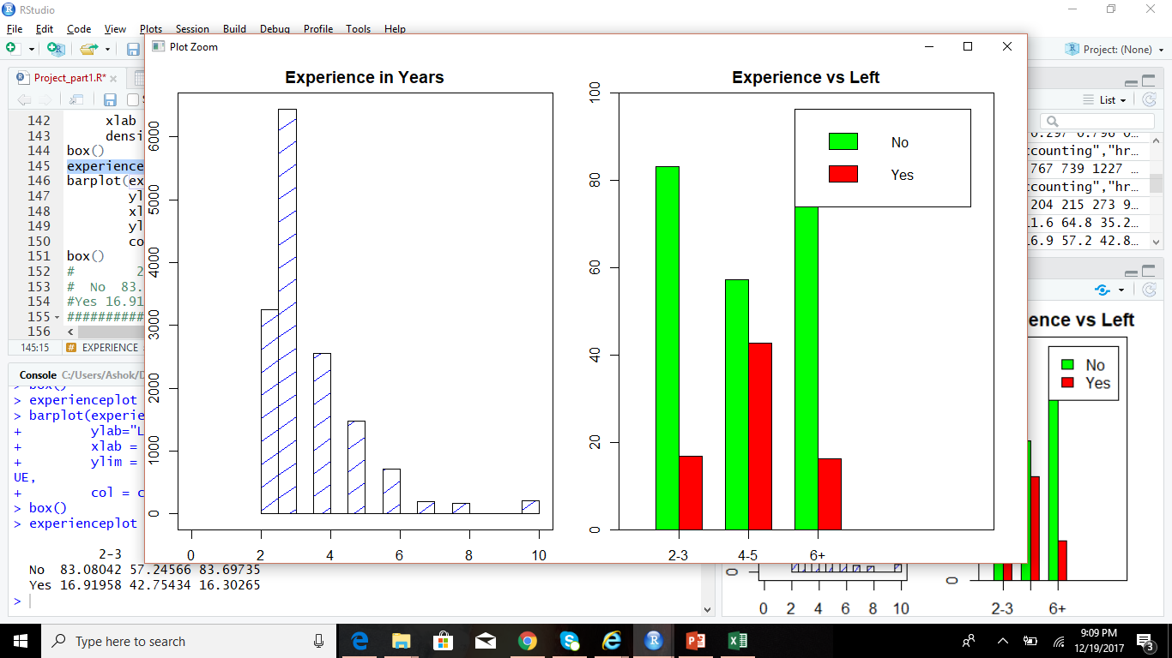
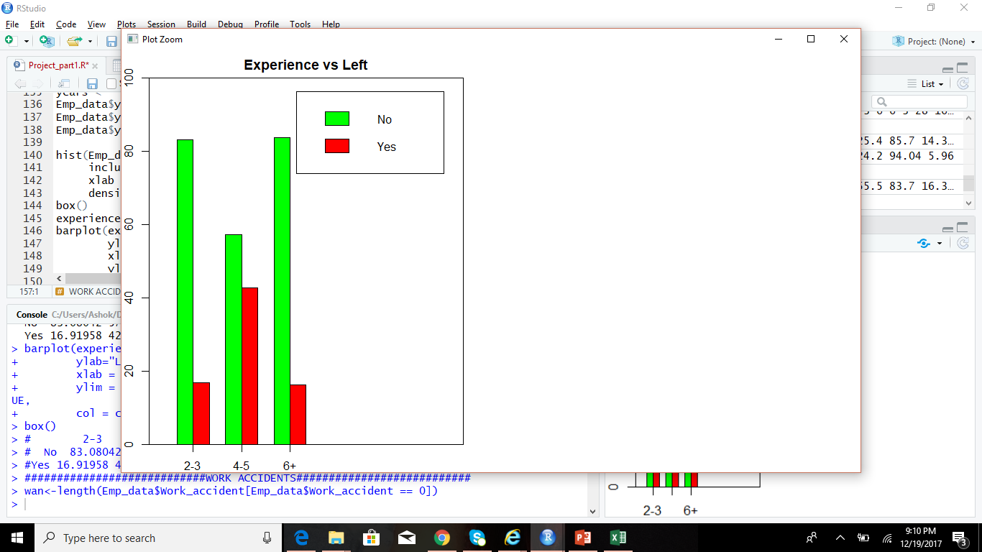
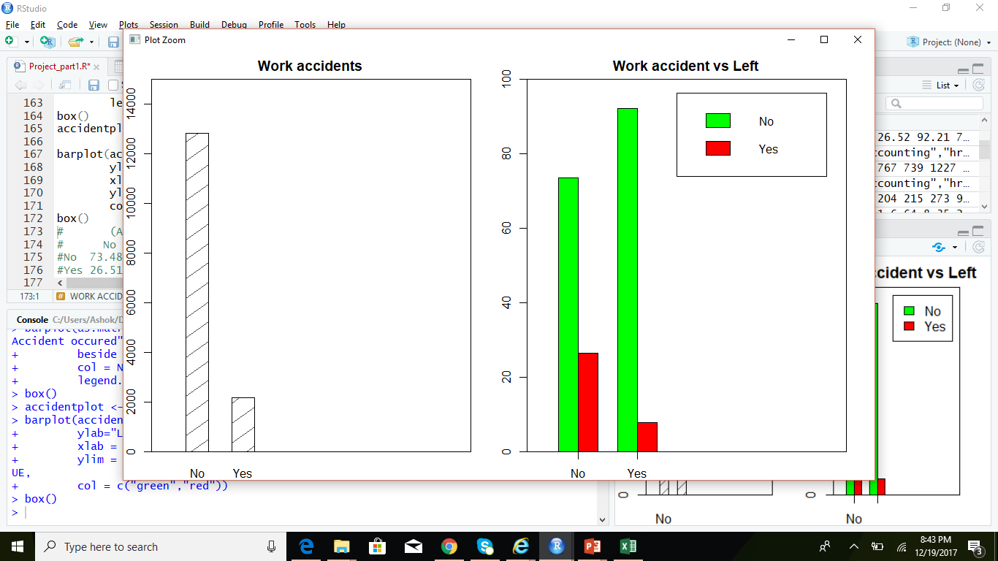
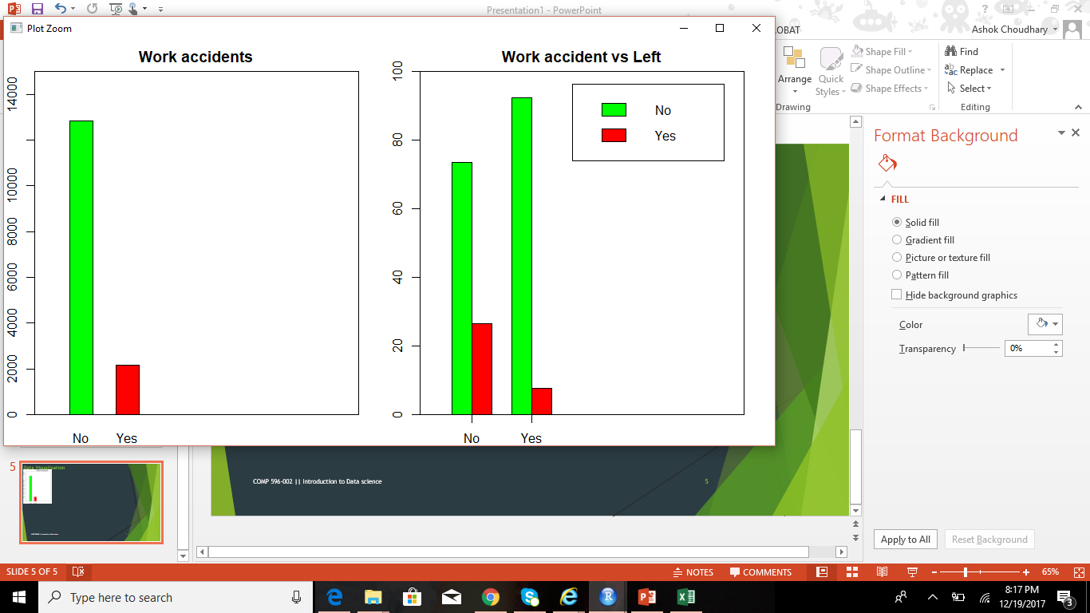
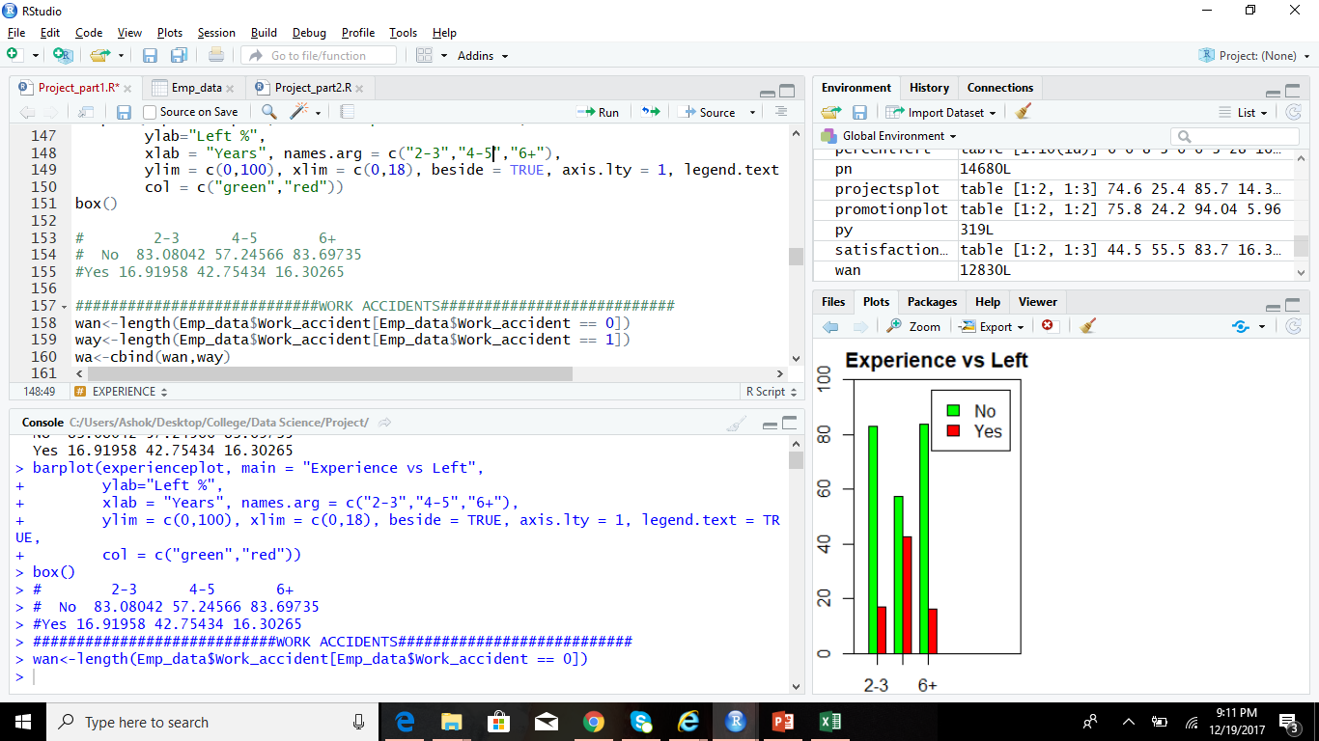
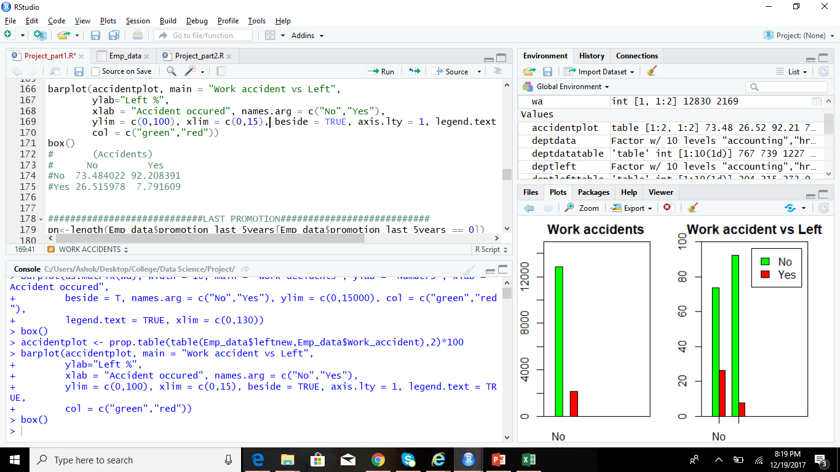
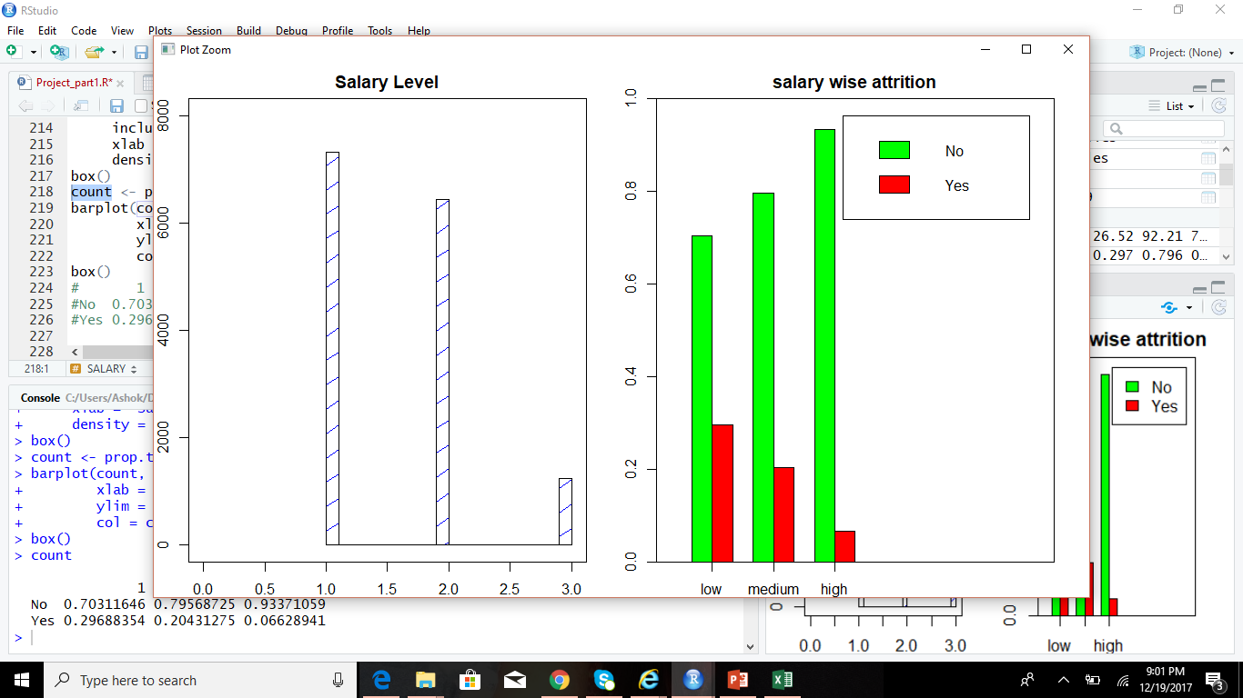
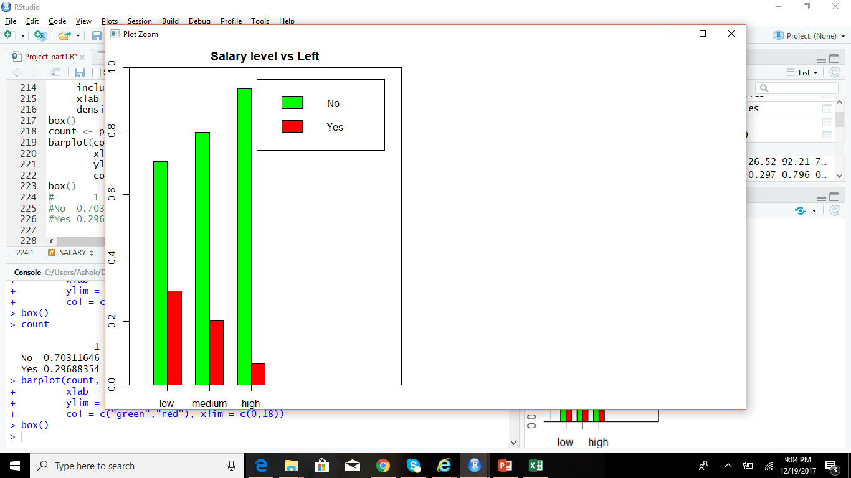
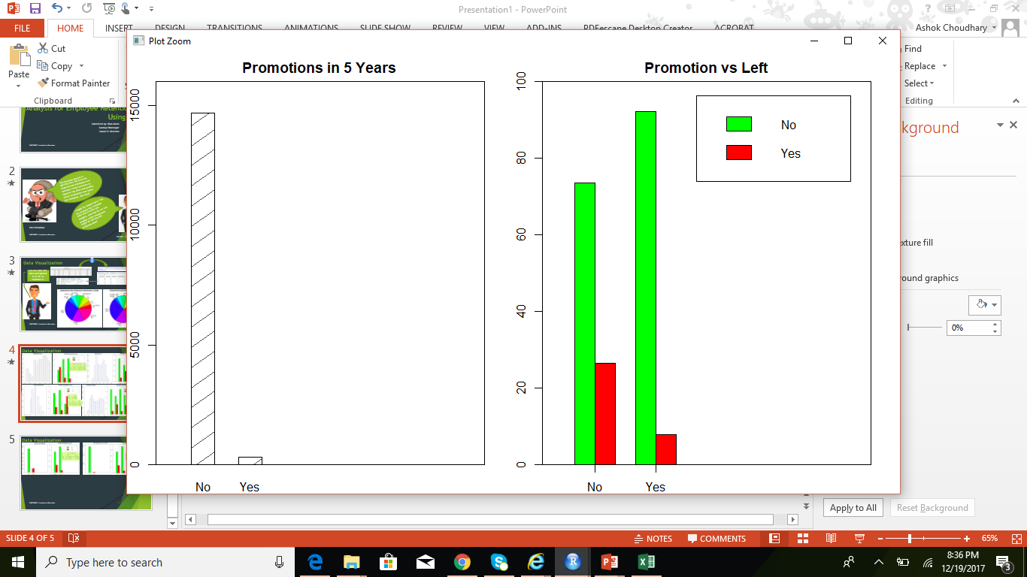
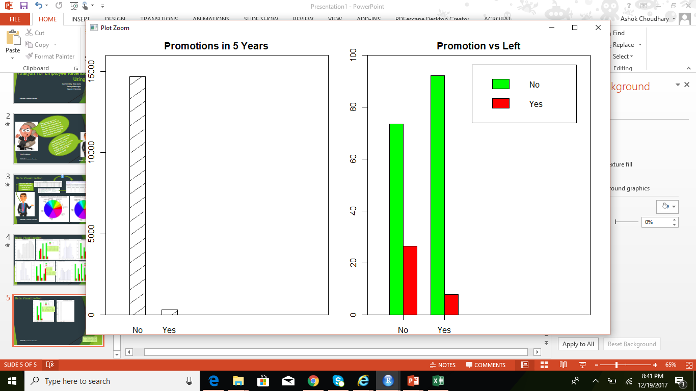
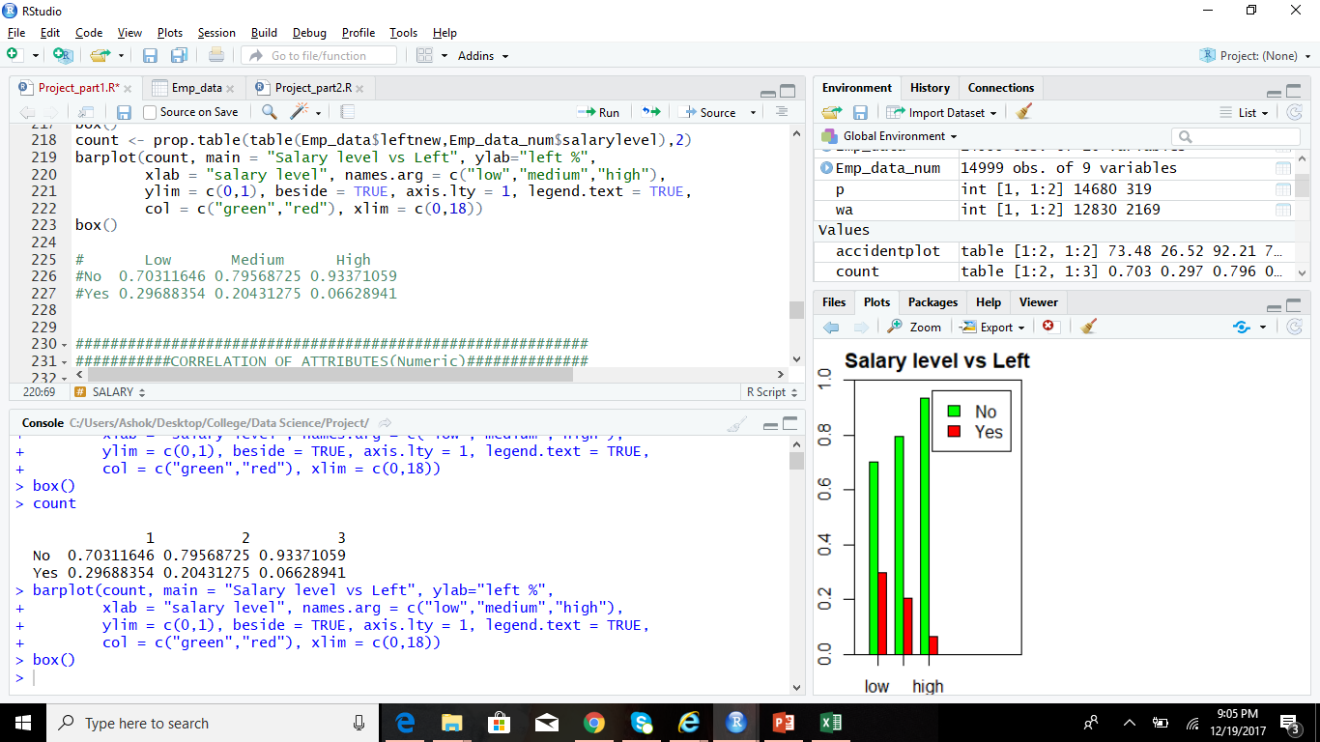
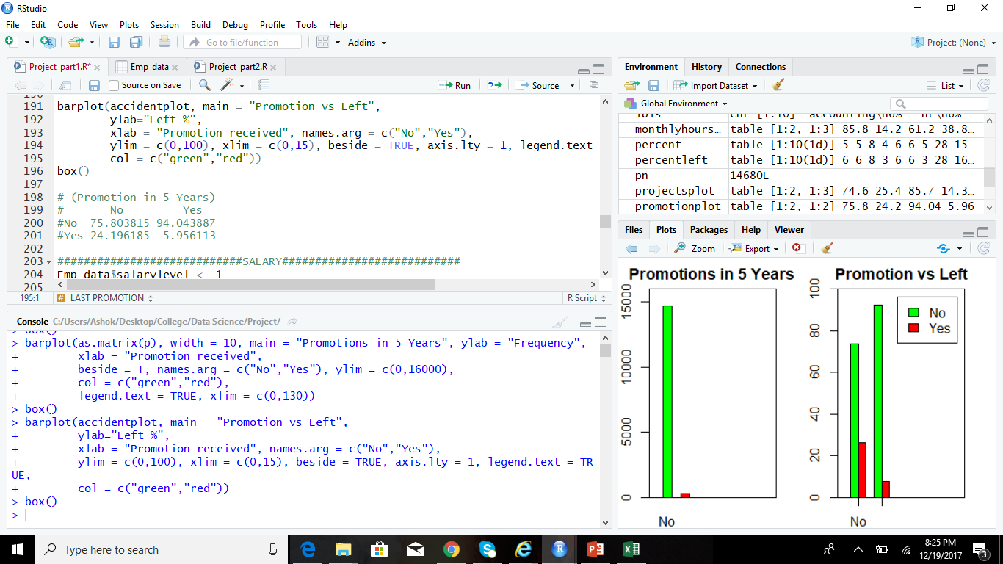
Data Visualization
Notes:
############################EXPERIENCE#############################
years <- '6+'
Emp_data$years <- '6+'
Emp_data$years[Emp_data$time_spend_company == 2 | Emp_data$time_spend_company == 3] <- '2-3'
Emp_data$years[Emp_data$time_spend_company == 4 | Emp_data$time_spend_company == 5] <- '4-5'
hist(Emp_data$time_spend_company, freq = T, xlim = c(0,10),ylim = NULL, border = "black",
include.lowest = T, main = "Experience in Years",
xlab = "Years", col = "Blue",
density = 10)
box()
experienceplot <- prop.table(table(Emp_data$leftnew,Emp_data$years),2)*100
barplot(experienceplot, main = "Experience vs Left",
ylab="Left %",
xlab = "Years", names.arg = c("2-3","4-5","6+"),
ylim = c(0,100), xlim = c(0,18), beside = TRUE, axis.lty = 1, legend.text = TRUE,
col = c("green","red"))
box()
# 2-3 4-5 6+
# No 83.08042 57.24566 83.69735
#Yes 16.91958 42.75434 16.30265
############################WORK ACCIDENTS###########################
wan<-length(Emp_data$Work_accident[Emp_data$Work_accident == 0])
way<-length(Emp_data$Work_accident[Emp_data$Work_accident == 1])
wa<-cbind(wan,way)
barplot(as.matrix(wa), width = 10, main = "Work accidents", ylab = "Numbers", xlab = "Accident occured",
beside = T, names.arg = c("No","Yes"), ylim = c(0,15000),
col = NULL, density = c(10,10),
legend.text = TRUE, xlim = c(0,130))
box()
accidentplot <- prop.table(table(Emp_data$leftnew,Emp_data$Work_accident),2)*100
barplot(accidentplot, main = "Work accident vs Left",
ylab="Left %",
xlab = "Accident occured", names.arg = c("No","Yes"),
ylim = c(0,100), xlim = c(0,15), beside = TRUE, axis.lty = 1, legend.text = TRUE,
col = c("green","red"))
box()
# (Accidents)
# No Yes
#No 73.484022 92.208391
#Yes 26.515978 7.791609
############################LAST PROMOTION###########################
pn<-length(Emp_data$promotion_last_5years[Emp_data$promotion_last_5years == 0])
py<-length(Emp_data$promotion_last_5years[Emp_data$promotion_last_5years == 1])
p<-cbind(pn,py)
barplot(as.matrix(p), width = 10, main = "Promotions in 5 Years", ylab = "Frequency",
xlab = "Promotion received",
beside = T, names.arg = c("No","Yes"), ylim = c(0,16000),
col = NULL, density = c(10,10),
legend.text = TRUE, xlim = c(0,130))
box()
promotionplot <- prop.table(table(Emp_data$leftnew,Emp_data$promotion_last_5years),2)*100
barplot(accidentplot, main = "Promotion vs Left",
ylab="Left %",
xlab = "Promotion received", names.arg = c("No","Yes"),
ylim = c(0,100), xlim = c(0,15), beside = TRUE, axis.lty = 1, legend.text = TRUE,
col = c("green","red"))
box()
# (Promotion in 5 Years)
# No Yes
#No 75.803815 94.043887
#Yes 24.196185 5.956113
############################SALARY###########################
Emp_data$salarylevel <- 1
Emp_data$salarylevel[Emp_data$salary == 'medium'] <- 2
Emp_data$salarylevel[Emp_data$salary == 'high'] <- 3
View(Emp_data)
head(Emp_data)
Emp_data_num <- Emp_data[,c(1,2,3,4,5,6,8,16,7)]
par(mar=c(2,2,2,2))
hist(Emp_data_num$salarylevel, freq = T, xlim = c(0,3),ylim = c(0,8000),
border = "black",
include.lowest = T, main = "Salary Level",
xlab = "Salary", col = "Blue",
density = 10)
box()
count <- prop.table(table(Emp_data$leftnew,Emp_data_num$salarylevel),2)
barplot(count, main = "Salary level vs Left", ylab="left %",
xlab = "salary level", names.arg = c("low","medium","high"),
ylim = c(0,1), beside = TRUE, axis.lty = 1, legend.text = TRUE,
col = c("green","red"), xlim = c(0,18))
box()
# Low Medium High
#No 0.70311646 0.79568725 0.93371059
#Yes 0.29688354 0.20431275 0.06628941

Slide 6
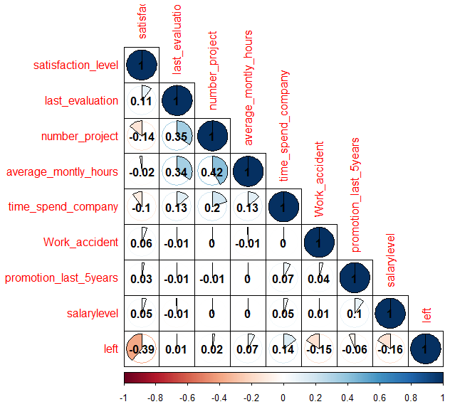

Data Visualization
So many attributes!, but it is difficult to track if they are related…
We can check the Correlation matrix

Slide 7
Prediction Models
Training Data
70%
To build a prediction model, we will have to split the dataset into training and testing data
Emp_data
30%
Testing Data
Naïve Bayes
Probabilistic classifier
Decision Tree
Each node represents a test on the feature
Random Forest
Constructs multitude of Decision trees
Independence Assumption between features
Based on Bayes’ Theorem
Provides visual representation of decisions based on which outcome will be predicted
Classification selected is the mode of all the decision tree classes
Machine Learning Algorithm
Classifier
Prediction

Slide 8
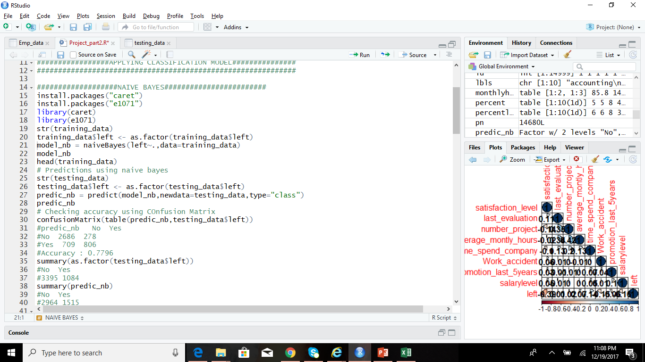
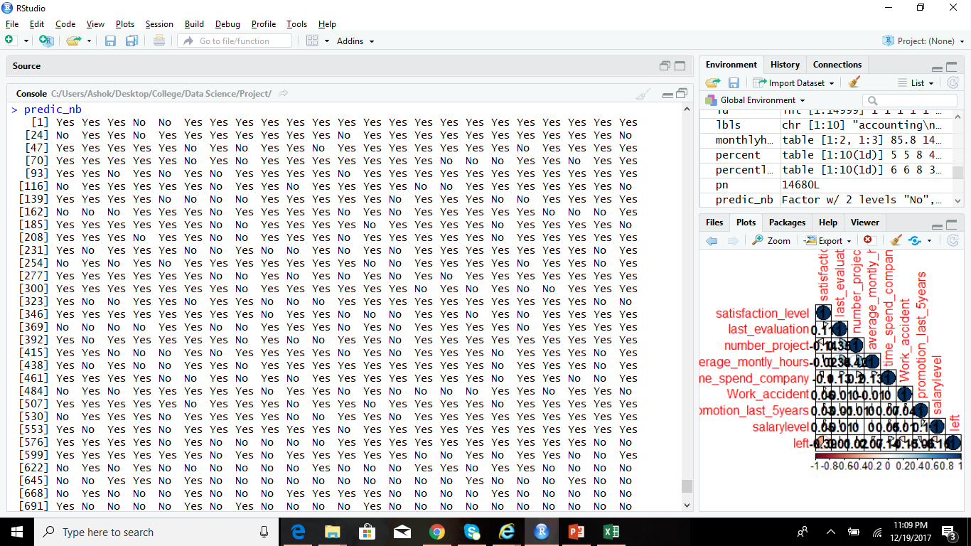
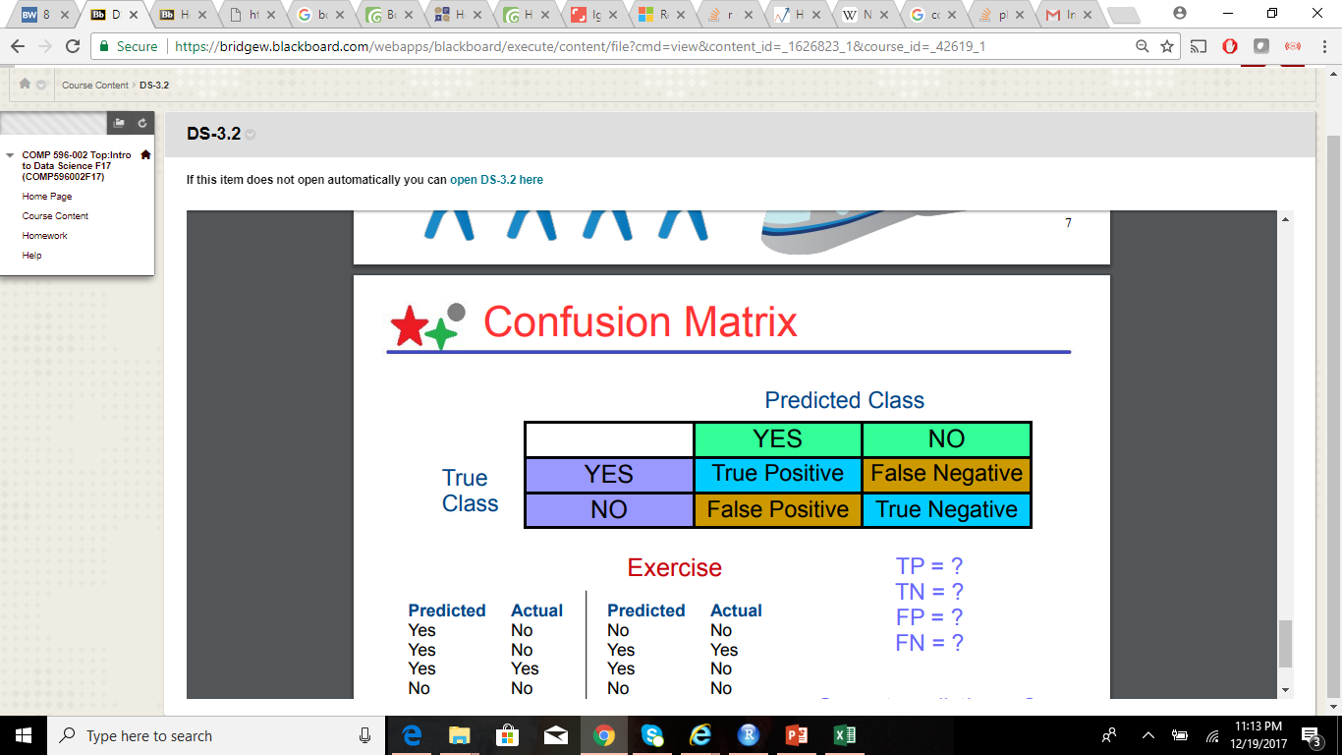
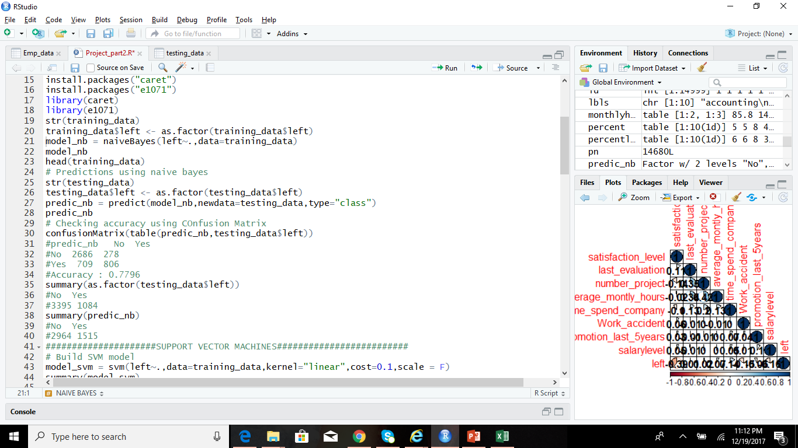
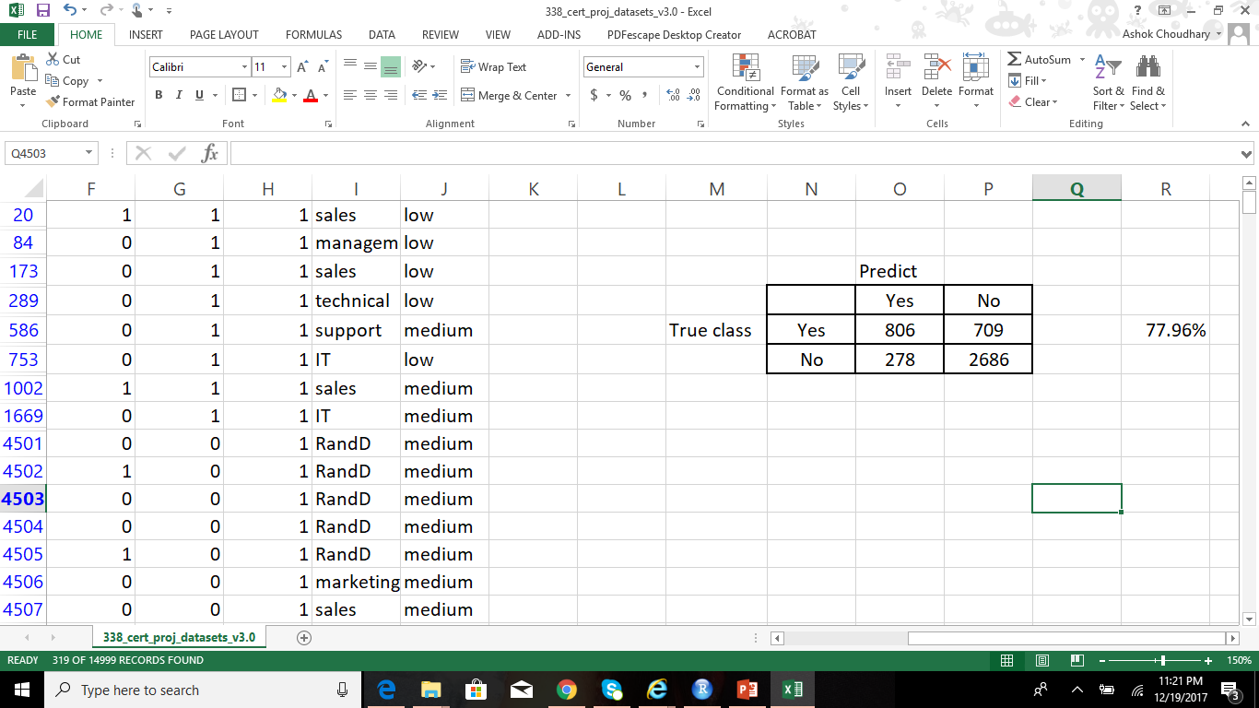
Prediction Models – Naïve Bayes
Accuracy
77.96%
Notes:
###################NAIVE BAYES########################
install.packages("caret")
install.packages("e1071")
library(caret)
library(e1071)
str(training_data)
training_data$left <- as.factor(training_data$left)
model_nb = naiveBayes(left~.,data=training_data)
model_nb
head(training_data)
# Predictions using naive bayes
str(testing_data)
testing_data$left <- as.factor(testing_data$left)
predic_nb = predict(model_nb,newdata=testing_data,type="class")
predic_nb
# Checking accuracy using COnfusion Matrix
confusionMatrix(table(predic_nb,testing_data$left))
#predic_nb
# No Yes
#No 2686 278
#Yes 709 806
#Accuracy : 0.7796
summary(as.factor(testing_data$left))
#No Yes
#3395 1084
summary(predic_nb)
#No Yes
#2964 1515

Slide 9
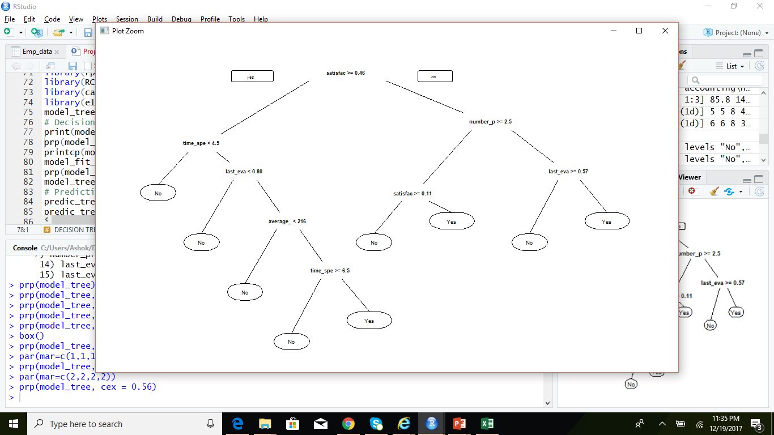
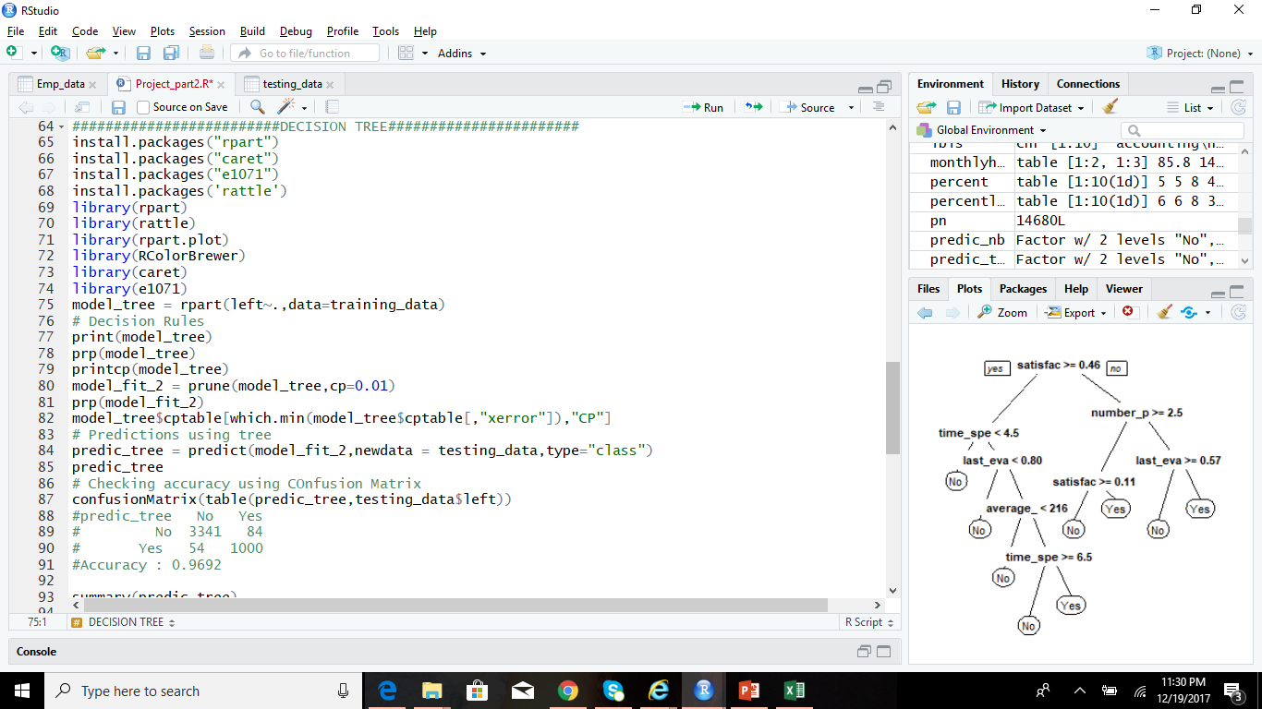
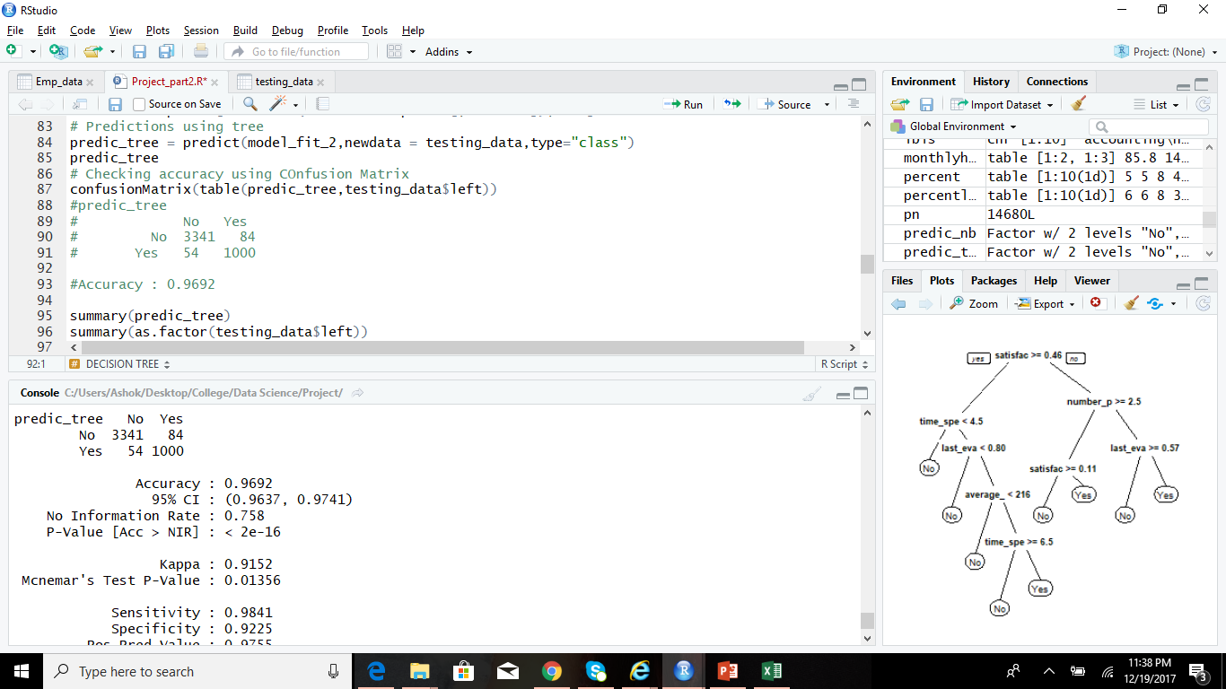
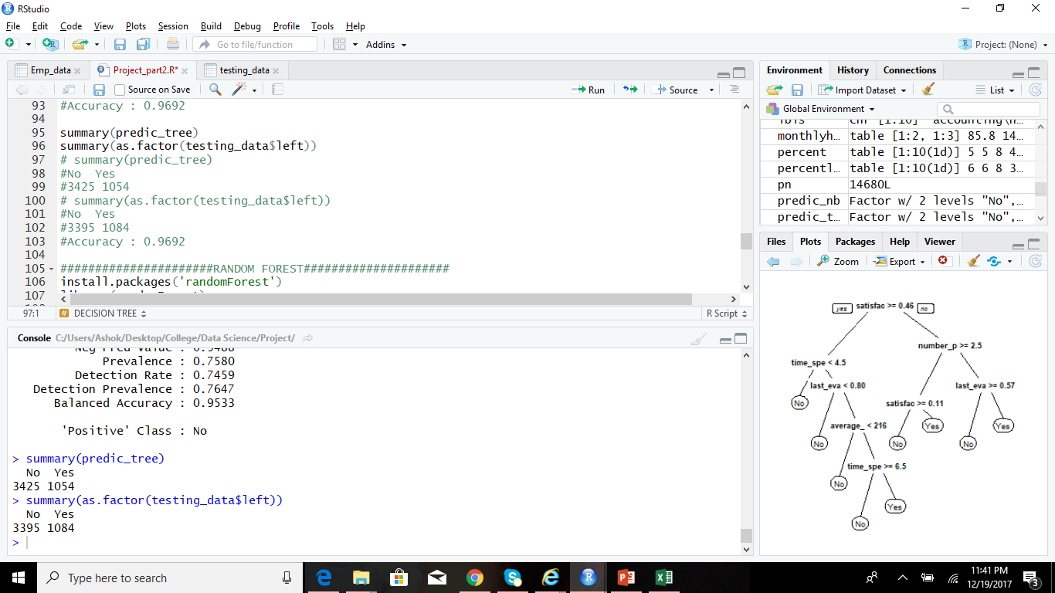
Prediction Models – Decision Tree
Accuracy
96.92%
Notes:
#########################DECISION TREE#######################
install.packages("rpart")
install.packages("caret")
install.packages("e1071")
install.packages('rattle')
library(rpart)
library(rattle)
library(rpart.plot)
library(RColorBrewer)
library(caret)
library(e1071)
model_tree = rpart(left~.,data=training_data)
# Decision Rules
print(model_tree)
prp(model_tree, cex = 0.56)
printcp(model_tree)
model_fit_2 = prune(model_tree,cp=0.01)
prp(model_fit_2)
model_tree$cptable[which.min(model_tree$cptable[,"xerror"]),"CP"]
# Predictions using tree
predic_tree = predict(model_fit_2,newdata = testing_data,type="class")
predic_tree
# Checking accuracy using COnfusion Matrix
confusionMatrix(table(predic_tree,testing_data$left))
#predic_tree
# No Yes
# No 3341 84
# Yes 54 1000
#Accuracy : 0.9692
summary(predic_tree)
summary(as.factor(testing_data$left))
# summary(predic_tree)
#No Yes
#3425 1054
# summary(as.factor(testing_data$left))
#No Yes
#3395 1084
#Accuracy : 0.9692

Slide 10
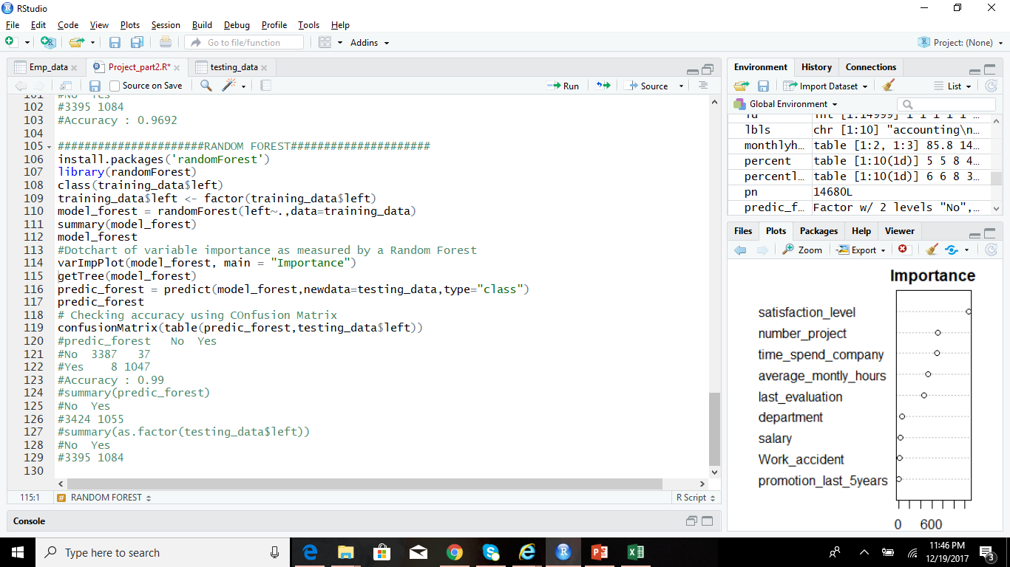

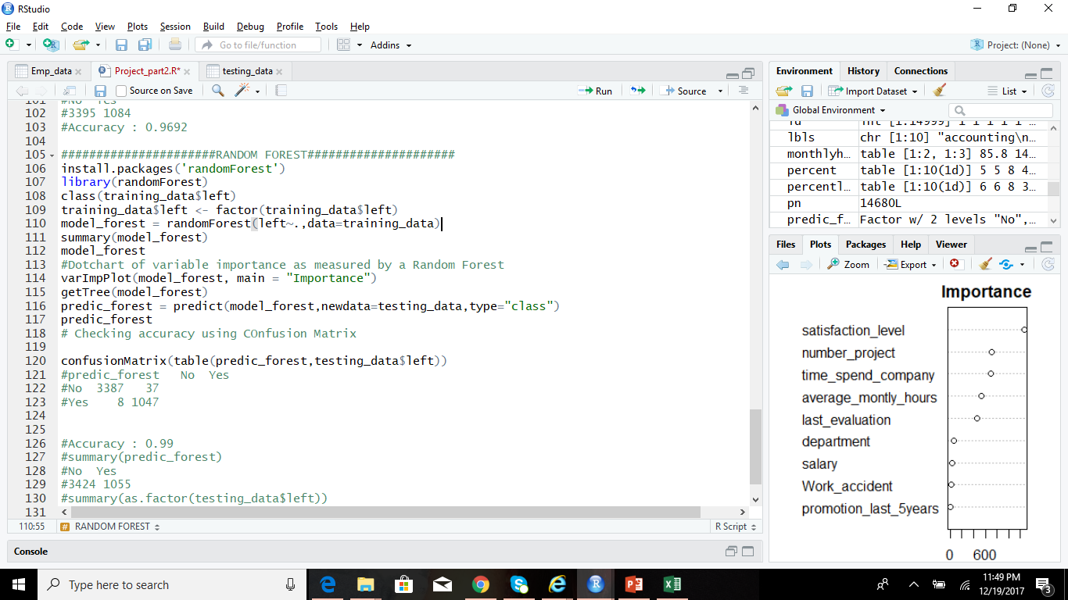

Prediction Models – Random Forest
Accuracy
99.04%
Notes:
######################RANDOM FOREST#####################
install.packages('randomForest')
library(randomForest)
class(training_data$left)
training_data$left <- factor(training_data$left)
model_forest = randomForest(left~.,data=training_data)
summary(model_forest)
model_forest
#Dotchart of variable importance as measured by a Random Forest
varImpPlot(model_forest, main = "Importance")
getTree(model_forest)
predic_forest = predict(model_forest,newdata=testing_data,type="class")
predic_forest
# Checking accuracy using COnfusion Matrix
confusionMatrix(table(predic_forest,testing_data$left))
#predic_forest No Yes
#No 3387 37
#Yes 8 1047
#Accuracy : 0.99
#summary(predic_forest)
#No Yes
#3424 1055
#summary(as.factor(testing_data$left))
#No Yes
#3395 1084

Slide 11


Thank You!
99% Accuray!! What sorcery is this!?
Its science..
Data Science!

